Slide 1
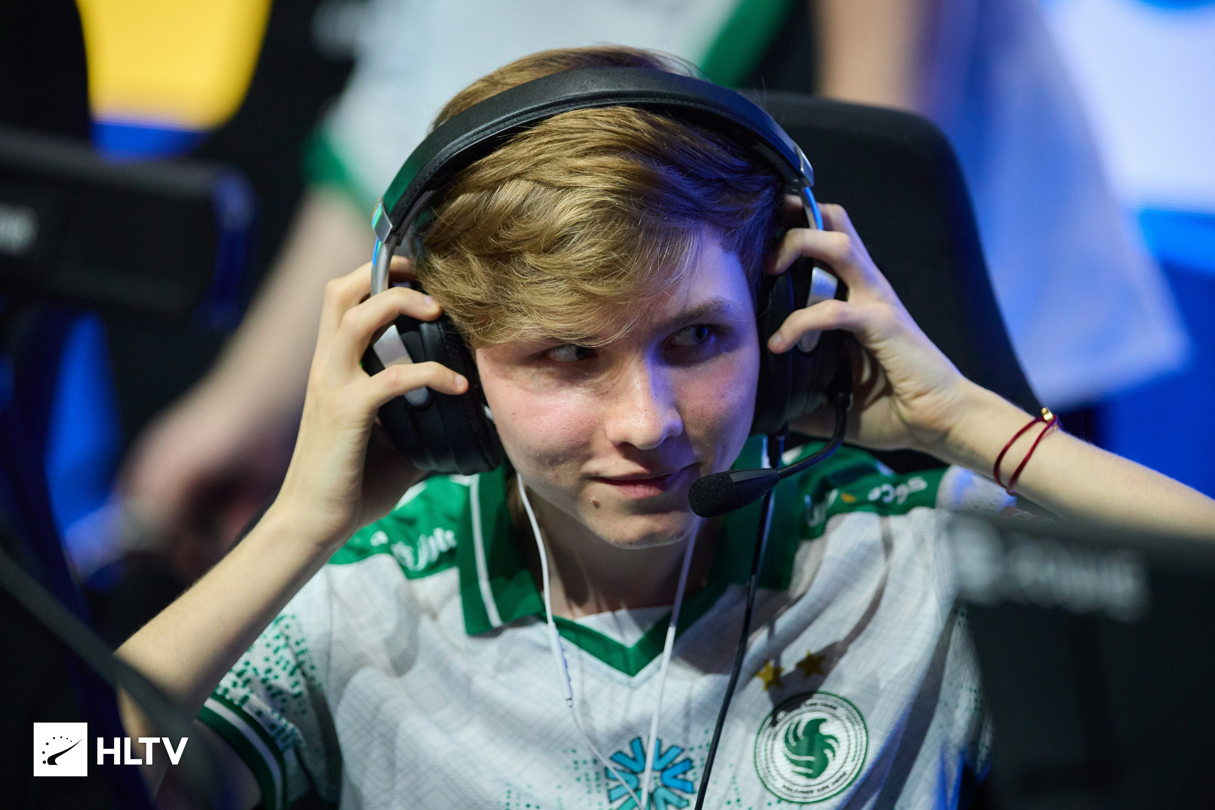
PUBLIC SPEECH
CYBER-
SPORT
Professional gaming:
from hobby to world-class level
Presentation based on a research essay

Slide 2
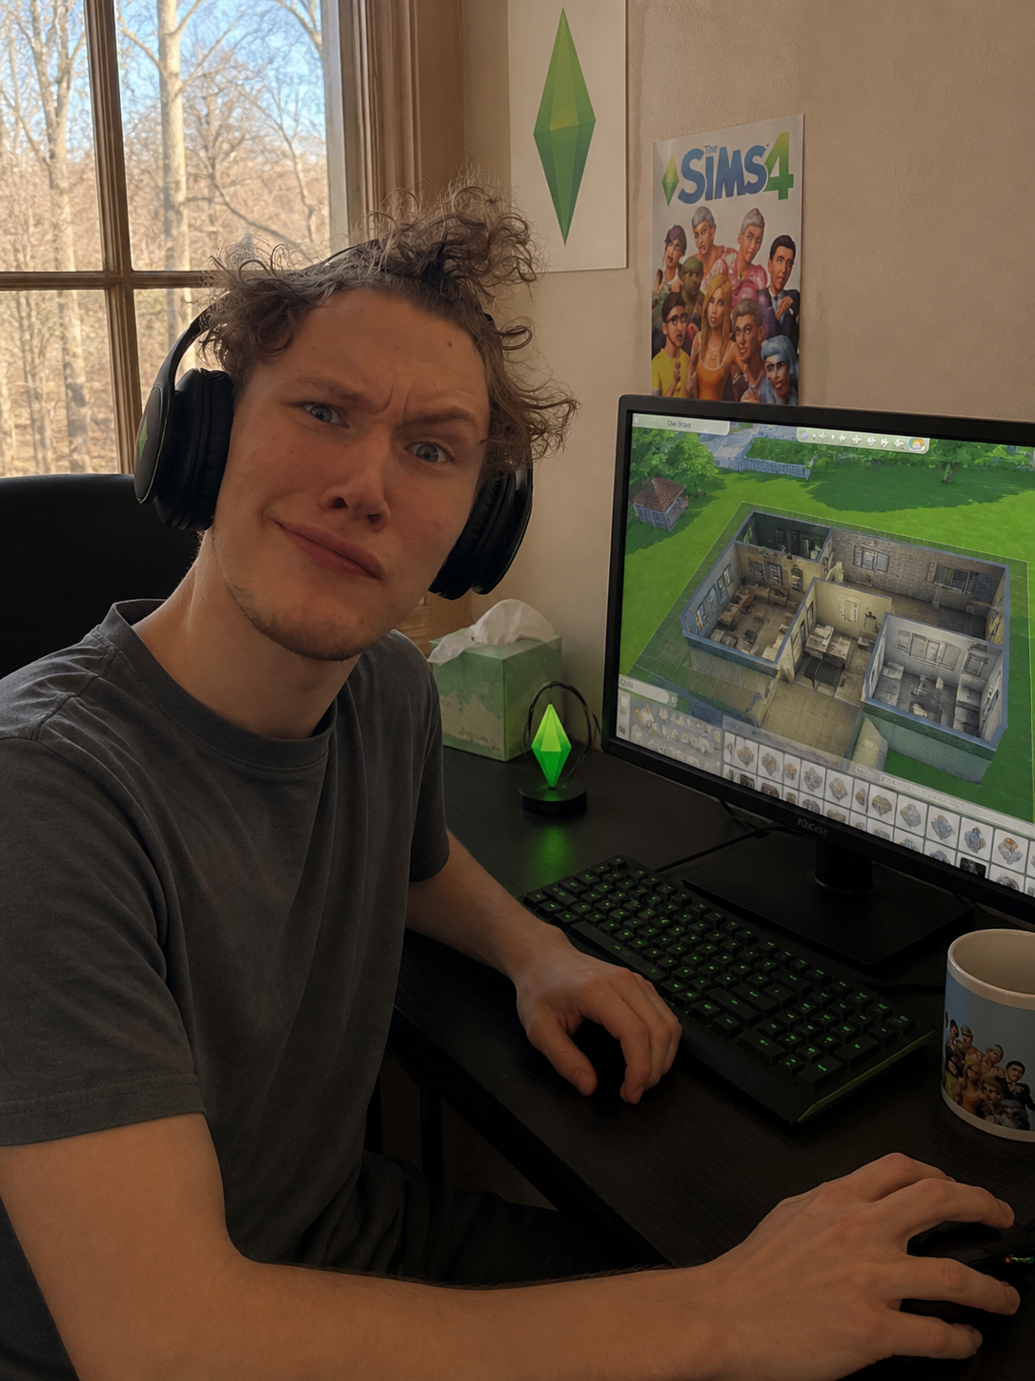
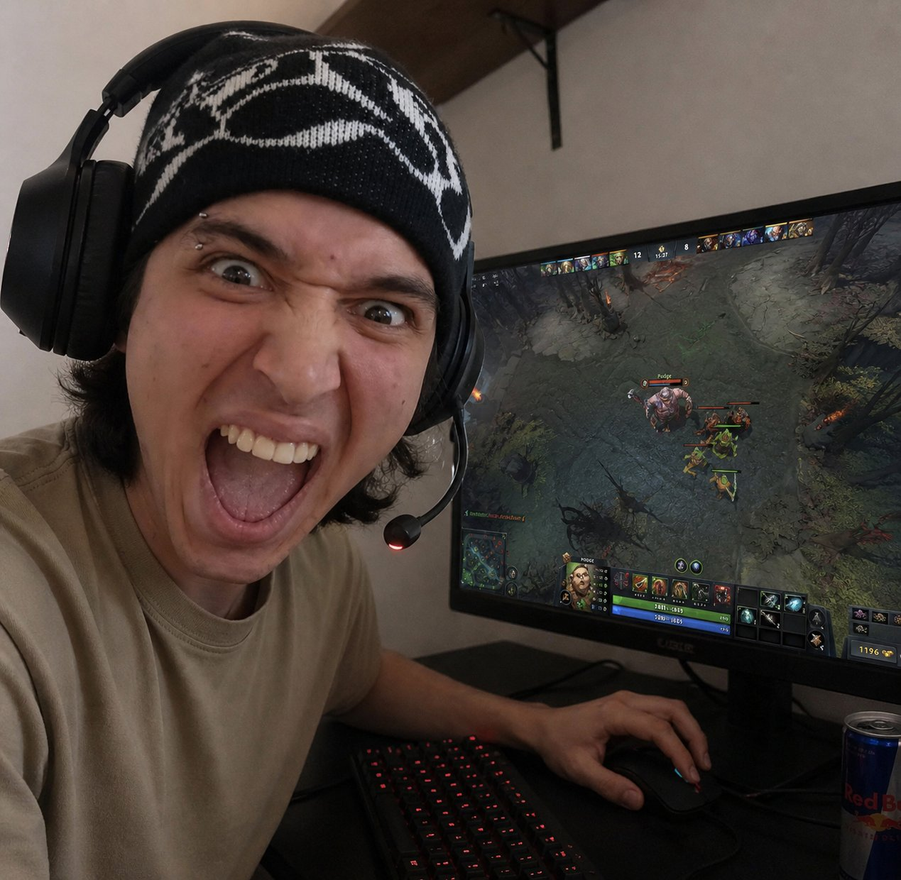
WHO ARE GAMERS?
1 / 3
Gaming is for everyone — from casual players to future champions
The Sims
Dota 2 fan
casual gaming
competitive spirit
Every gamer starts the same way — just sitting at a desk, playing a game they love.

Slide 3
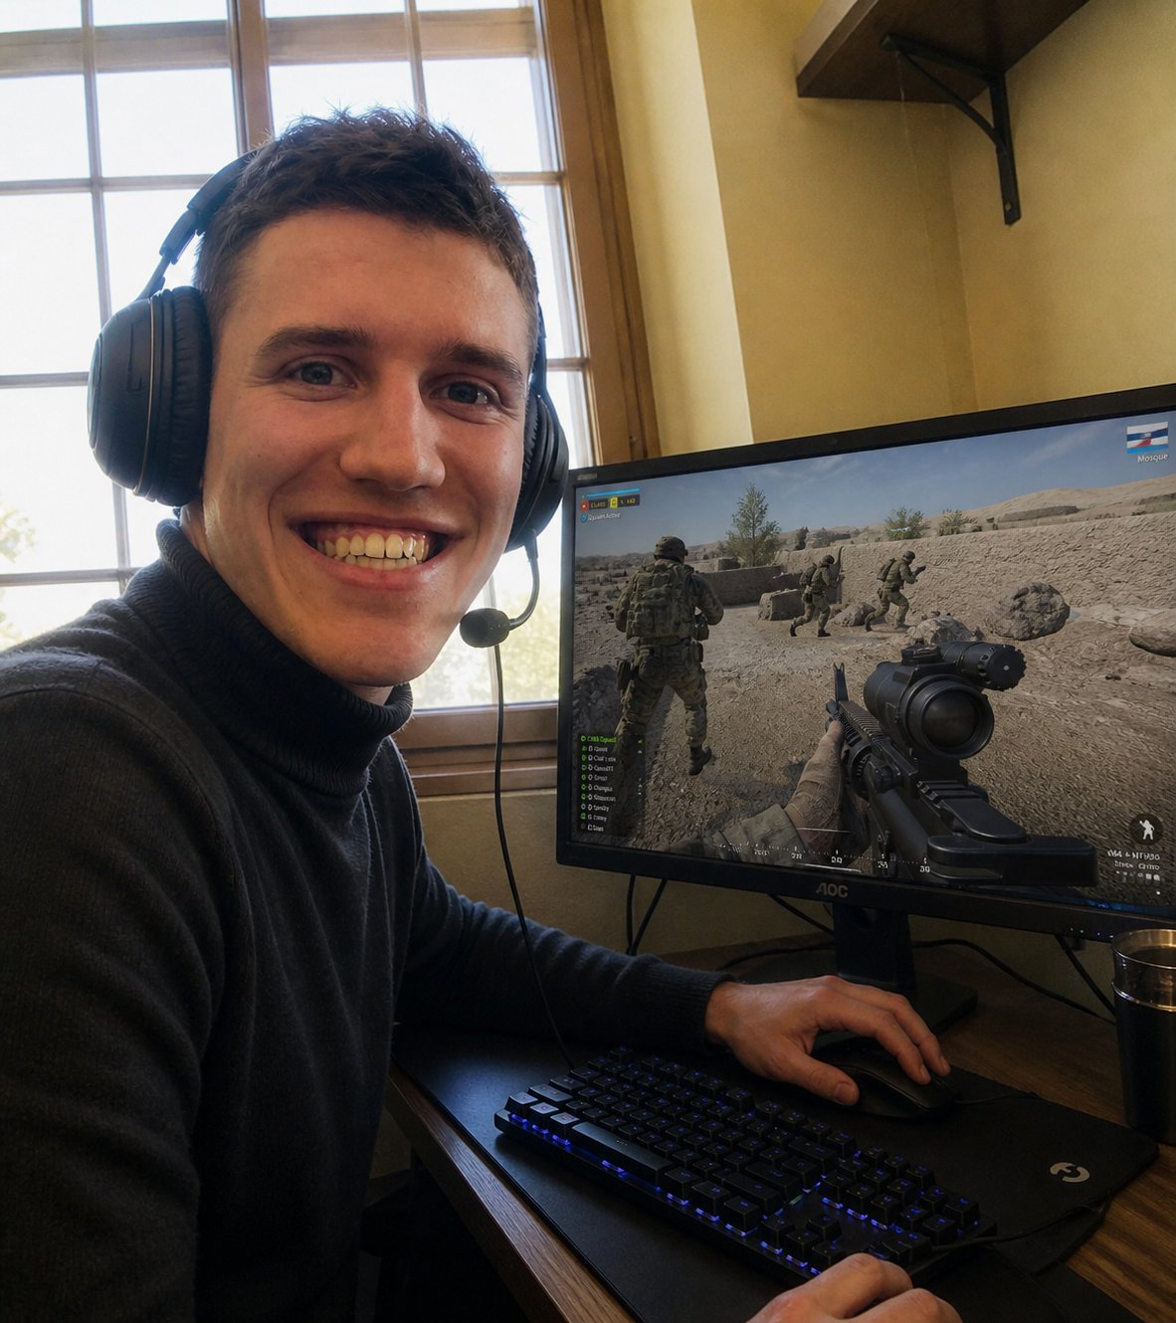
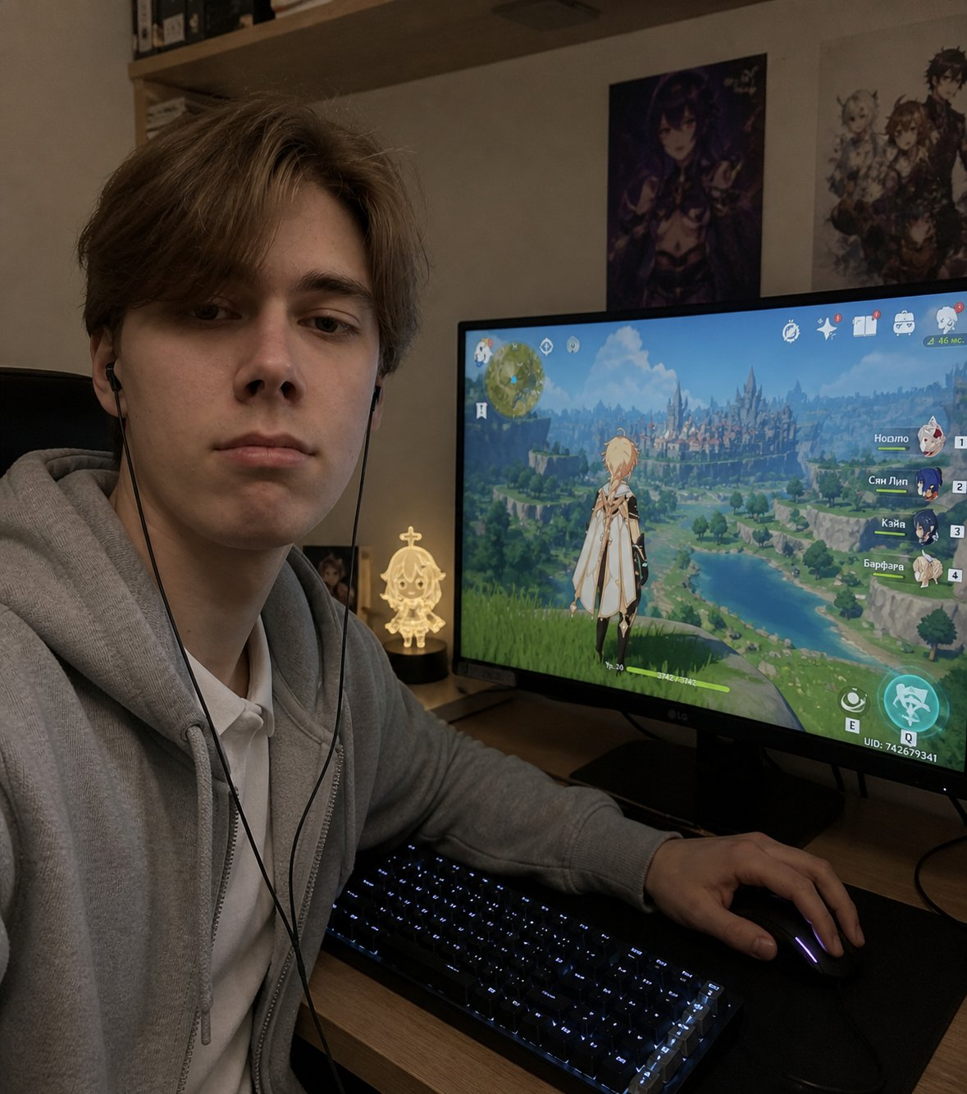
WHO ARE GAMERS?
2 / 3
Gaming is for everyone — from casual players to future champions
FPS gamer
Genshin Impact
shooter genre
RPG community
Every gamer starts the same way — just sitting at a desk, playing a game they love.

Slide 4
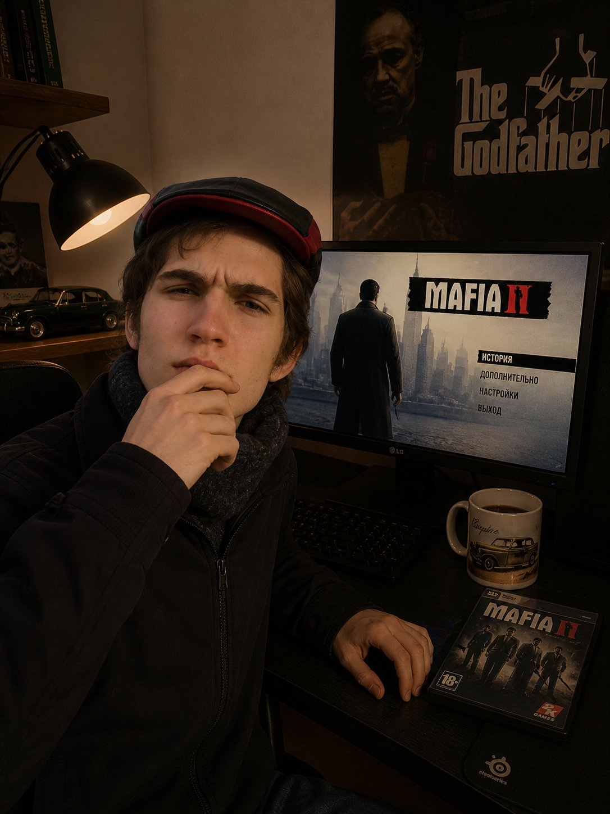
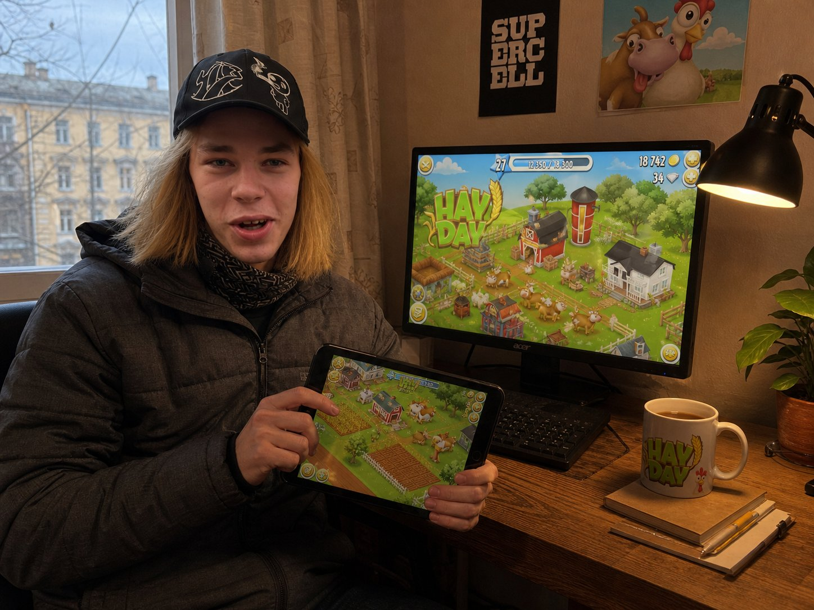
WHO ARE GAMERS?
3 / 3
Gaming is for everyone — from casual players to future champions
Mafia II fan
Hay Day player
story-driven games
mobile & casual
Every gamer starts the same way — just sitting at a desk, playing a game they love.

Slide 5
WHAT IS ESPORTS?
Esports is competitive video gaming at a professional level. Players compete in tournaments for prize money, sign contracts with organizations, and train just like traditional athletes.
🎮
🌍
💰
Disciplines
Scale
Industry
CS2, Dota 2, League of Legends, Valorant, FIFA and dozens of other titles
Over 500 million viewers watch esports events worldwide every year
The global esports market exceeds $1.5 billion in annual revenue

Slide 6
WHY DO YOUNG PEOPLE CHOOSE ESPORTS?
01
Accessibility
02
Community
All you need to start is a PC and internet. Anyone from anywhere in the world can enter esports, unlike traditional sports.
Millions-strong online communities, streams, and tournaments — young people find like-minded friends and build social bonds through gaming.
03
Career & Money
04
Recognition & Status
Pro players earn millions. Beyond gameplay, the industry offers careers as coaches, analysts, commentators and content creators.
Esports athletes are idols for millions. Winning a Major is comparable to triumphing at the Olympic Games.

Slide 7
HOW TO BECOME A PRO PLAYER?
1
Choose your discipline
Pick one game and focus on it. The best players are specialists, not generalists.
2
Ranked & online leagues
Start with ranked matches. Climb the ladder, study the meta, review your gameplay.
3
Local LANs & city tournaments
Compete in offline city and regional events — this is where scouts from organizations spot talent.
4
Academies & teams
Top orgs like Team Spirit and Falcons run academies. Get signed and grow professionally.
5
Professional scene
Regional leagues → international tournaments → Majors. It's a long road, but a real one.

Slide 8
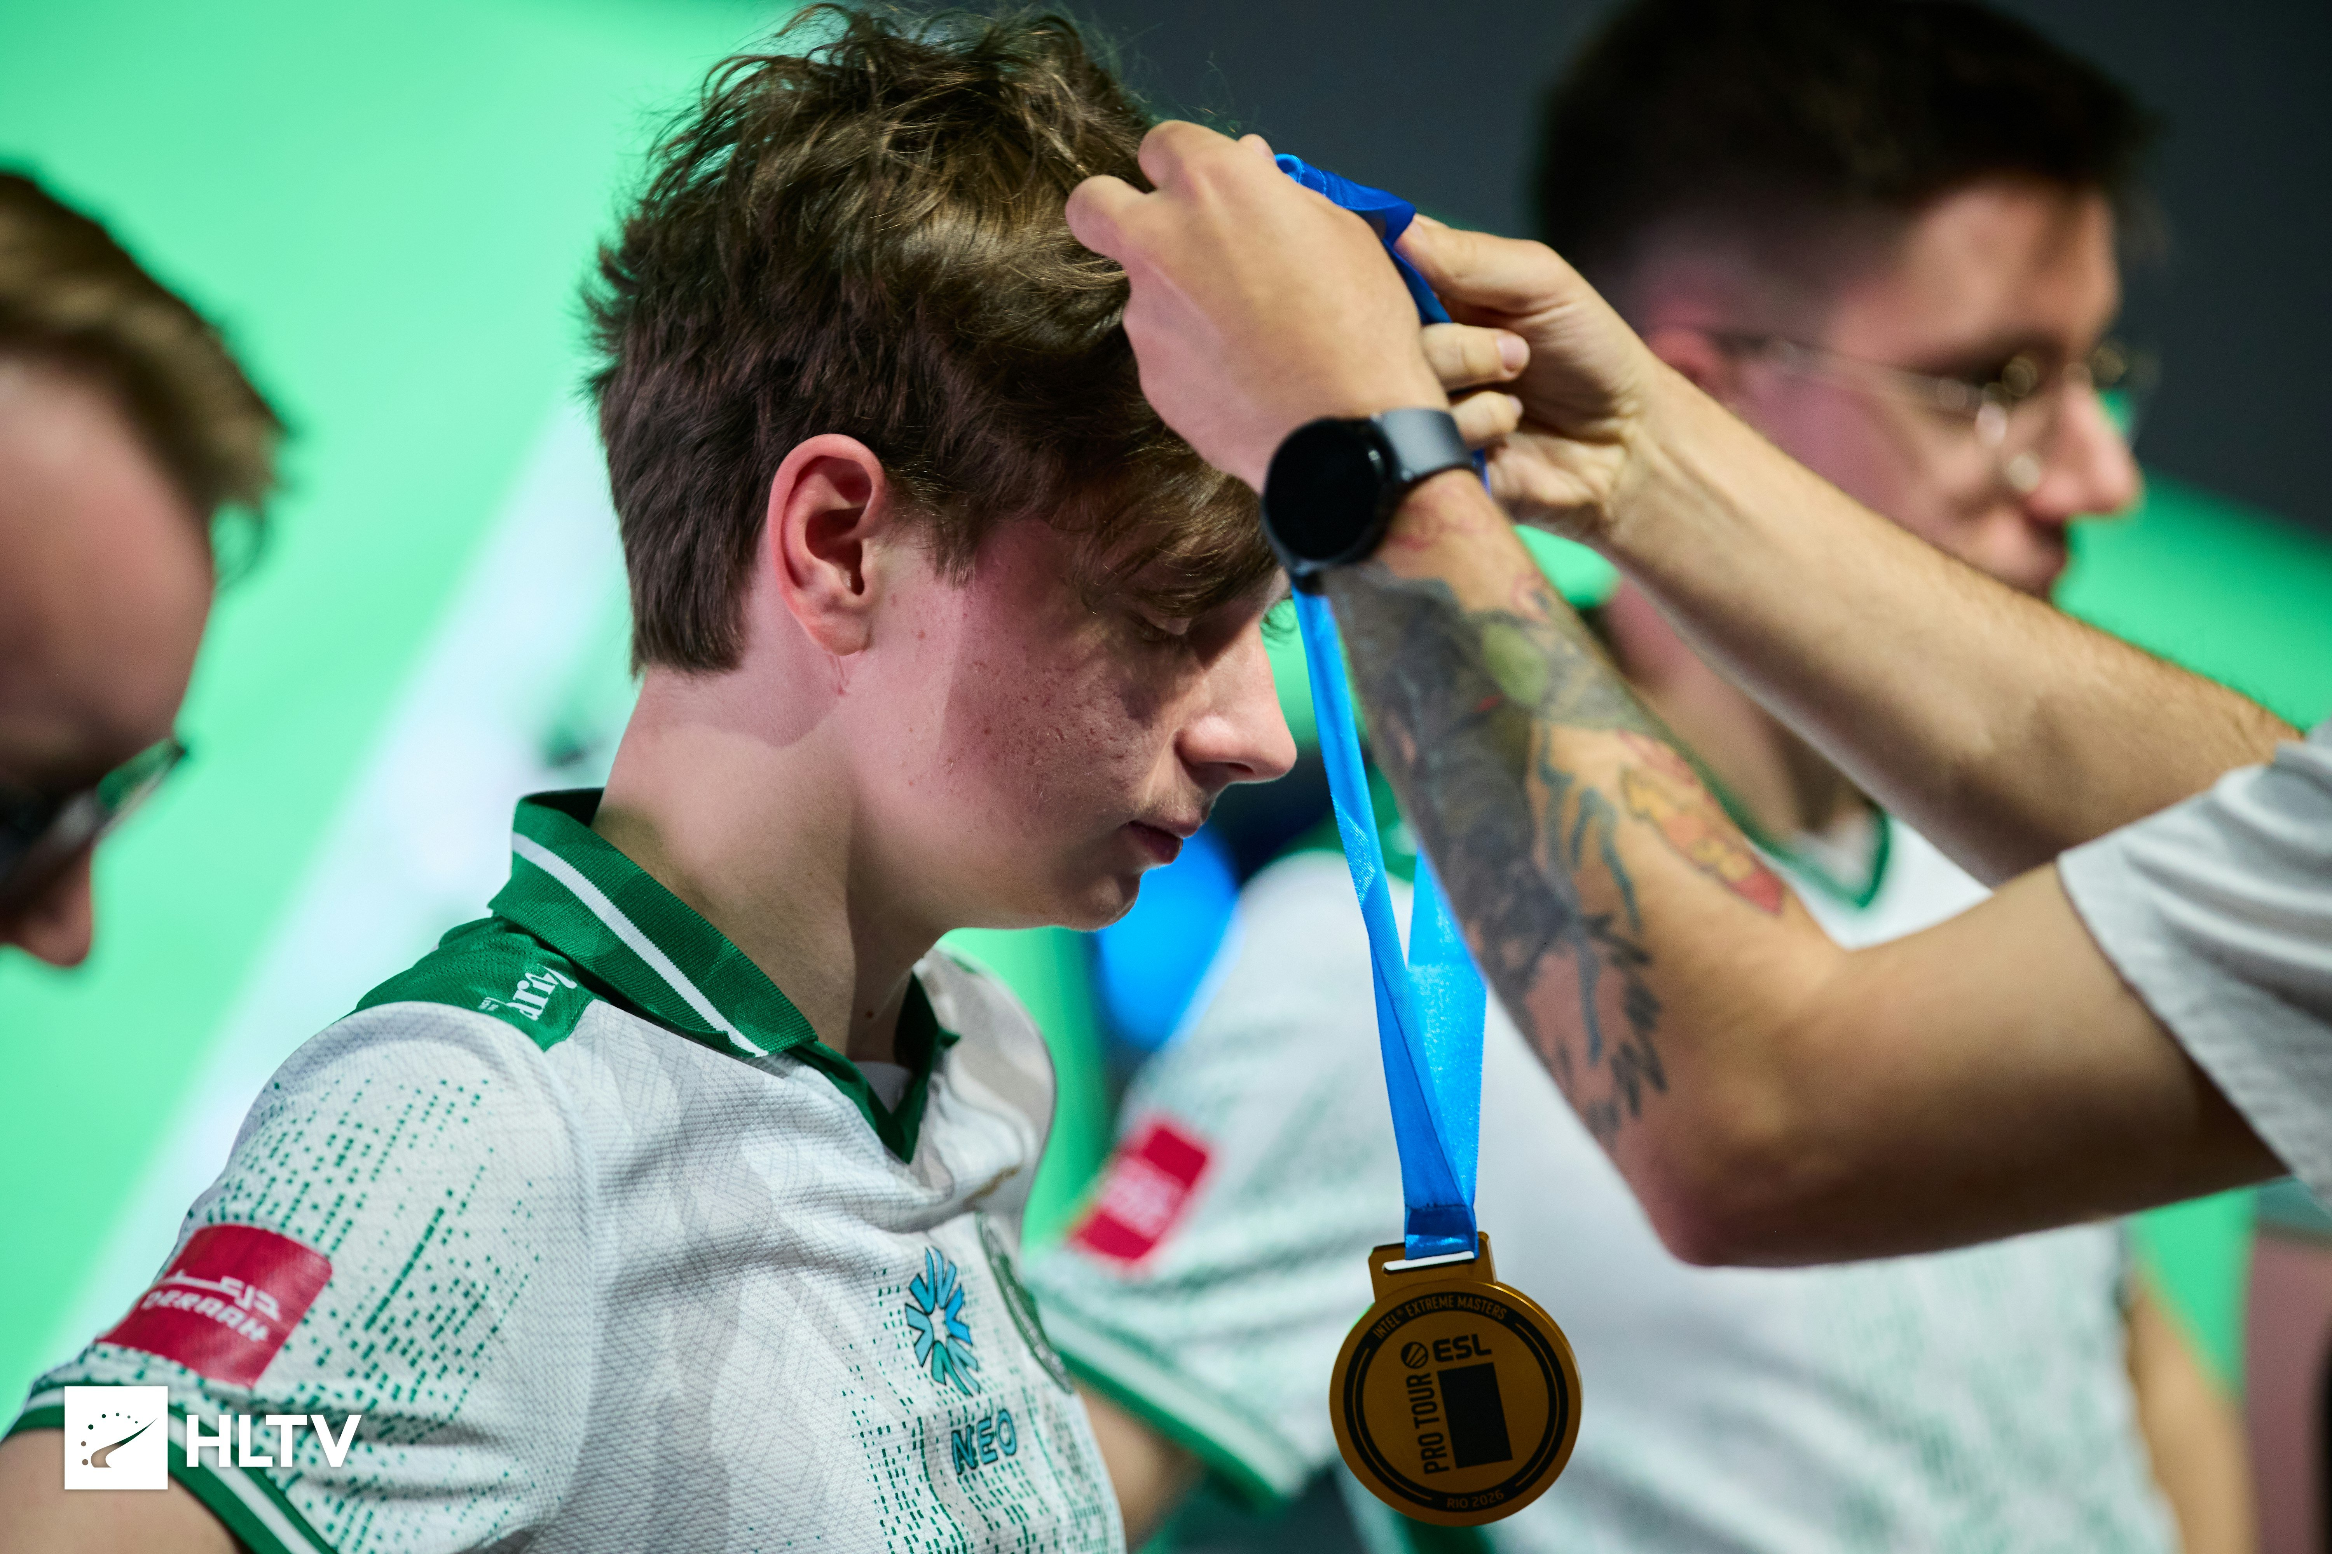
ESPORTS IS A REAL SPORT
⏰
10–14 hours of training per day
Pro players train just as much as Olympic athletes. Routine, discipline, VOD review — it's all the same as in traditional sport.
🧠
Analytics & strategy
Without tactical thinking, you won't go far. Teams study opponents, build strategies and adapt in real time.
🏆
Trophies are rare
Most professional players never win a major tournament. That's normal. The journey matters just as much as the win.

Slide 9
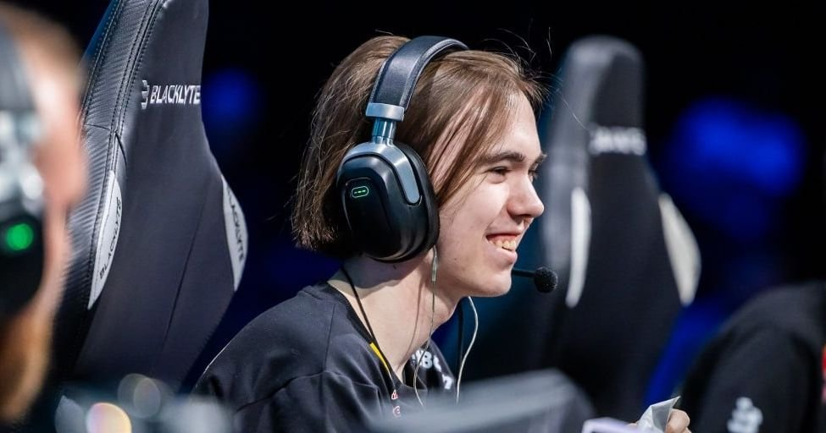
EXAMPLE: m0nesy & TEAM FALCONS
🌟 KEY FACTS
▸ m0nesy — one of the most talented young players in CS2
▸ Ranked top 2–4 on HLTV player ranking every year
▸ Plays for Team Falcons (Saudi Arabia)
Ilya «m0nesy» Osipov
Danil «donk» Isenbaev — Team Spirit
«Talent comes and goes — hard work stays forever»
▸ Falcons: rosters in CS2, Dota 2, FIFA and more
▸ The org runs its own talent academy

Slide 10
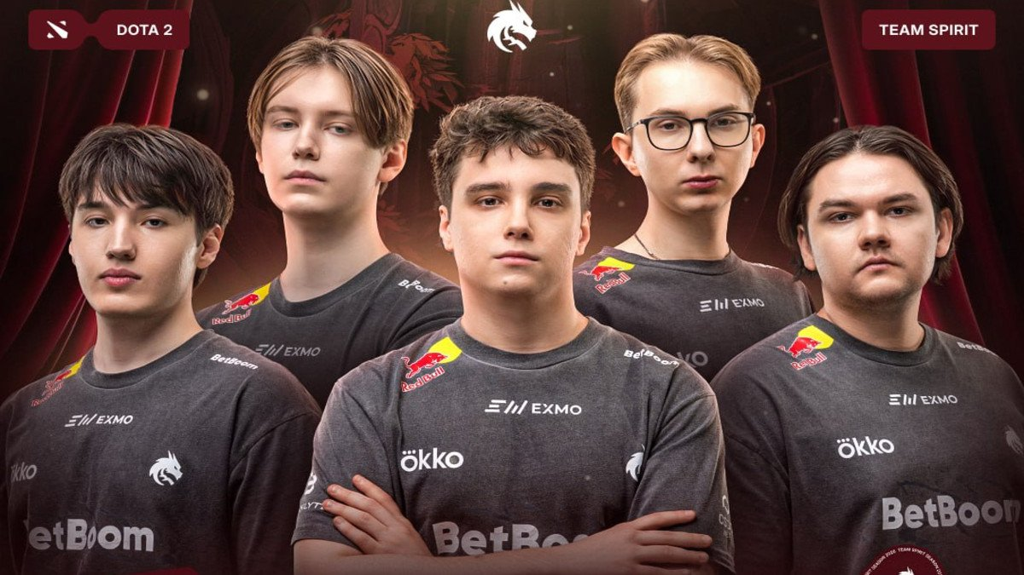
TEAM SPIRIT: RUSSIAN PRIDE
About the organization
Team Spirit is one of the strongest and most prominent esports organizations in the world. They field rosters in CS2, Dota 2, Valorant and other disciplines, and run their own talent academy.
Stars from the academy
«donk»
CS2 — HLTV world #1 ranked player
Team Spirit — Dota 2 roster
«kyousuke»
CS2 — one of the brightest young players
«yatoro»
Dota 2 — The International champion

Slide 11
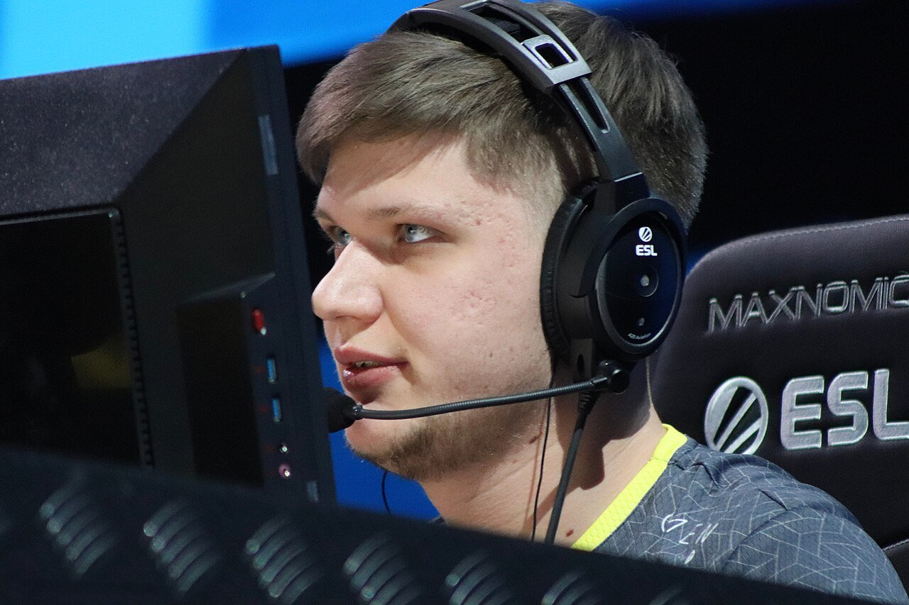
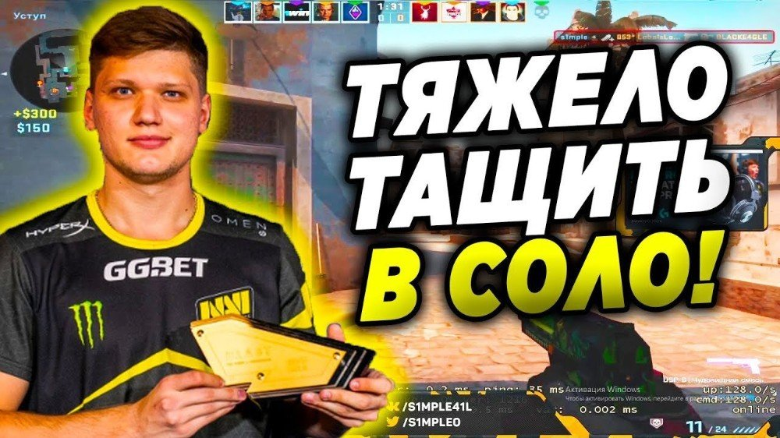
ALEXANDER «S1MPLE» KOSTYLEV
The legacy of a legend
S1mple is a professional player who spent most of his career at Natus Vincere.
His impact on CS extended far beyond personal achievements — he inspired millions of people to pick up a mouse and start playing Counter-Strike.
Personalities like him define the culture and attract new generations to esports.
2×
1×
#1
World's Best
Player (HLTV)
Major
Champion
All-time peak
HLTV ranking

Slide 12
CONCLUSION
Esports is a fully-fledged professional industry demanding talent, discipline, and years of hard work. It is not simply "gaming" — it is a complex ecosystem of teams, academies, coaches and a global audience of hundreds of millions.
📈
💪
🏢
Popularity is no accident
The path demands sacrifice
Organizations drive the industry
Accessibility + global community + career potential — the winning formula behind esports' rise among youth.
Thousands of hours of training, deep analysis, mental resilience — without these, the professional scene is out of reach.
Team Spirit, Falcons and other top orgs build the infrastructure that produces world-class talent.

Slide 13
SOURCES
1
HLTV.org — the official resource of the CS2 professional scene: player statistics, rankings, tournament history (hltv.org)
2
Team Spirit — official organization website: rosters, history, and talent academy (teamspirit.gg)
3
Team Falcons — official information about the organization and its disciplines (falcons.gg)
4
Author's personal observations: years of following the professional esports scene
5
Photo materials: HLTV.org — official press photos from CS2 events
Thank you for your attention! Any questions?

